Slide 1
Marketing Campaign Analysis for Portuguese Banking
By Lia Shabulal
21BCAF05

Slide 2
PROJECT OVERVIEW
Dataset Overview
The dataset at hand provides valuable insights into a marketing campaign conducted by a Portuguese financial institution. Through this analysis, we aim to identify key patterns and trends, enabling us to formulate strategic improvements for future marketing endeavours.
Objective: Improving Future Marketing Campaigns
Our primary goal is to meticulously examine this campaign's data. By doing so, we intend to discern effective strategies and areas of enhancement. This analysis serves as the foundation for shaping our future marketing initiatives, ensuring their precision and impact.

Slide 3
ATTRIBUTES
VARIABLE | INDICATES
A_O_DT | Account Open date
ACCOUNT_NB | Account Number
ASSET_LEVEL | B-Self property D-Joint property K- Rented(having property in different location) M-Rented property (No data available about property) S- Entrepreneur T-Skilled Migrator Y-Unknown
EDUCATION_LEVEL | Higher the number, better the qualification level
I_LM | Current balance amount
F_IN | Family income not available
F_S | Family Size
A1_LM-A18_LM | Last 18 months account balance
RATING_Q1-RATING_Q4(Last four quarter rating of the customer) | 0-Least active in that quarter 3-Average active in that quarter 6- Active in that quarter S-Highly Active in that quarter
Y/N | Has the client subscribed a term deposit? (binary: 'Yes','No')

Slide 4
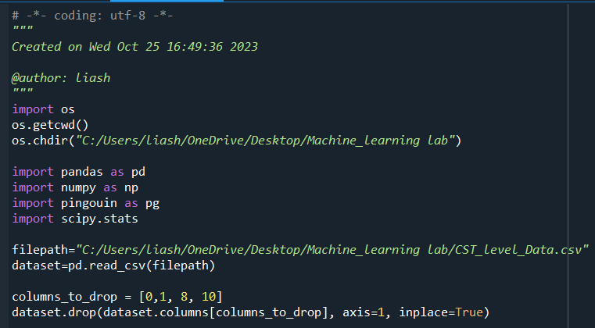

DATA PREPROCESSING
Total number of rows= 178523
Column 0 : Index with no heading
Column 1 : Empty column
Column 8 : Contains only blank cells
Column 10 : Empty column

Slide 5

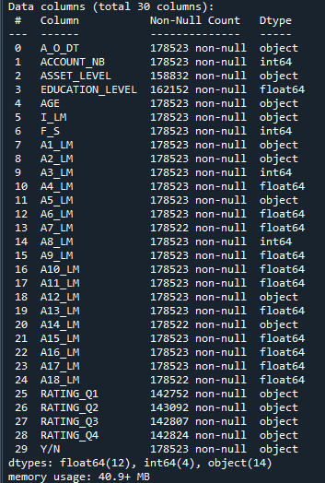
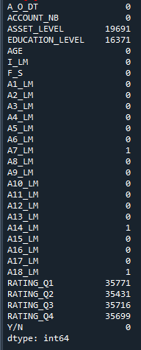
DATA PREPROCESSING

Slide 6
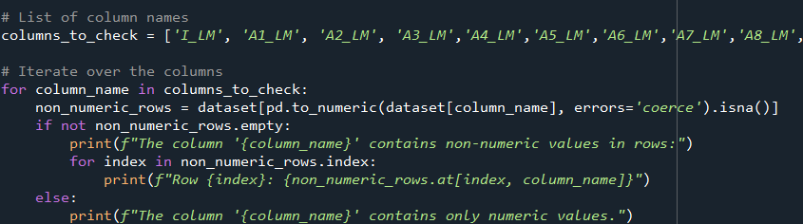
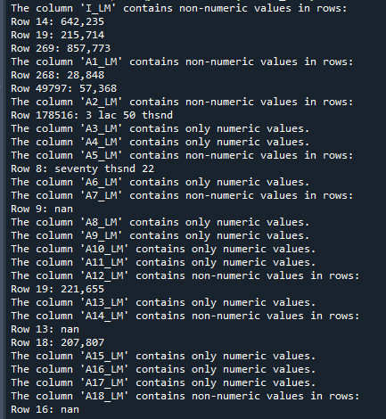
DATA PREPROCESSING

Slide 7
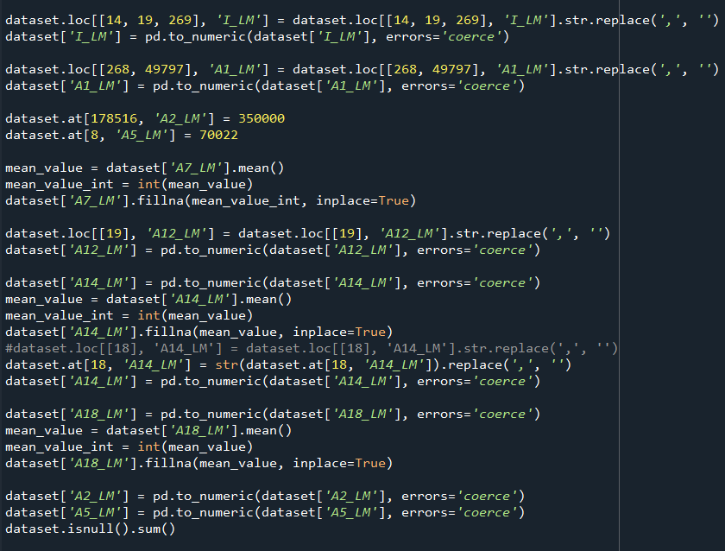
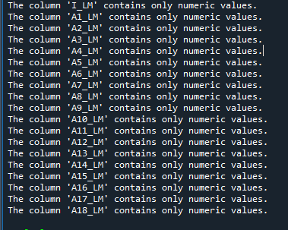
DATA PREPROCESSING

Slide 8
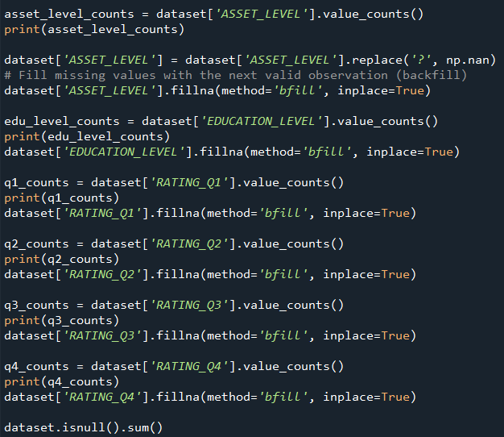
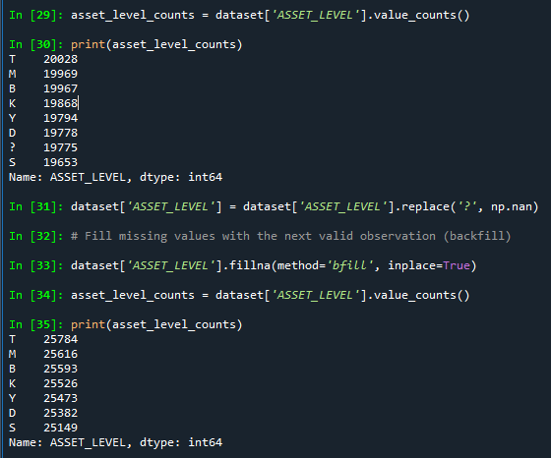
DATA PREPROCESSING

Slide 9
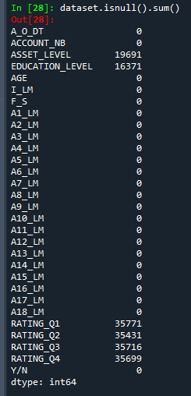
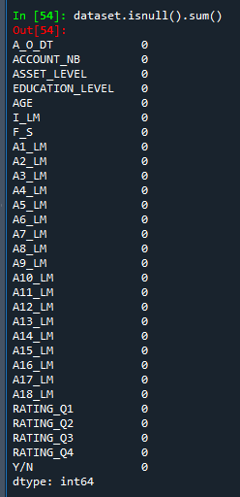
DATA PREPROCESSING

Slide 10
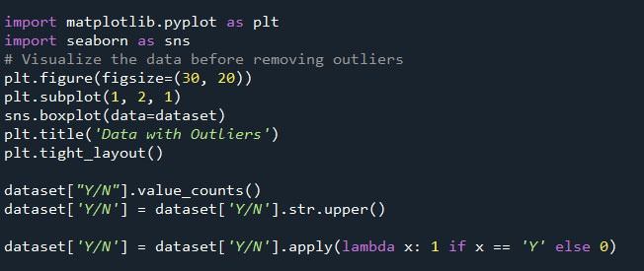
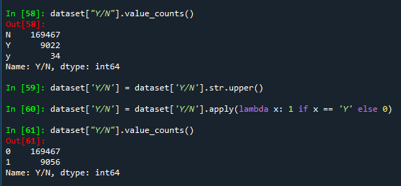
DATA PREPROCESSING

Slide 11
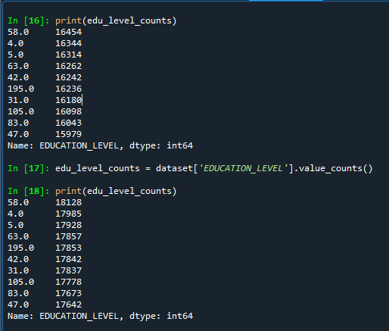
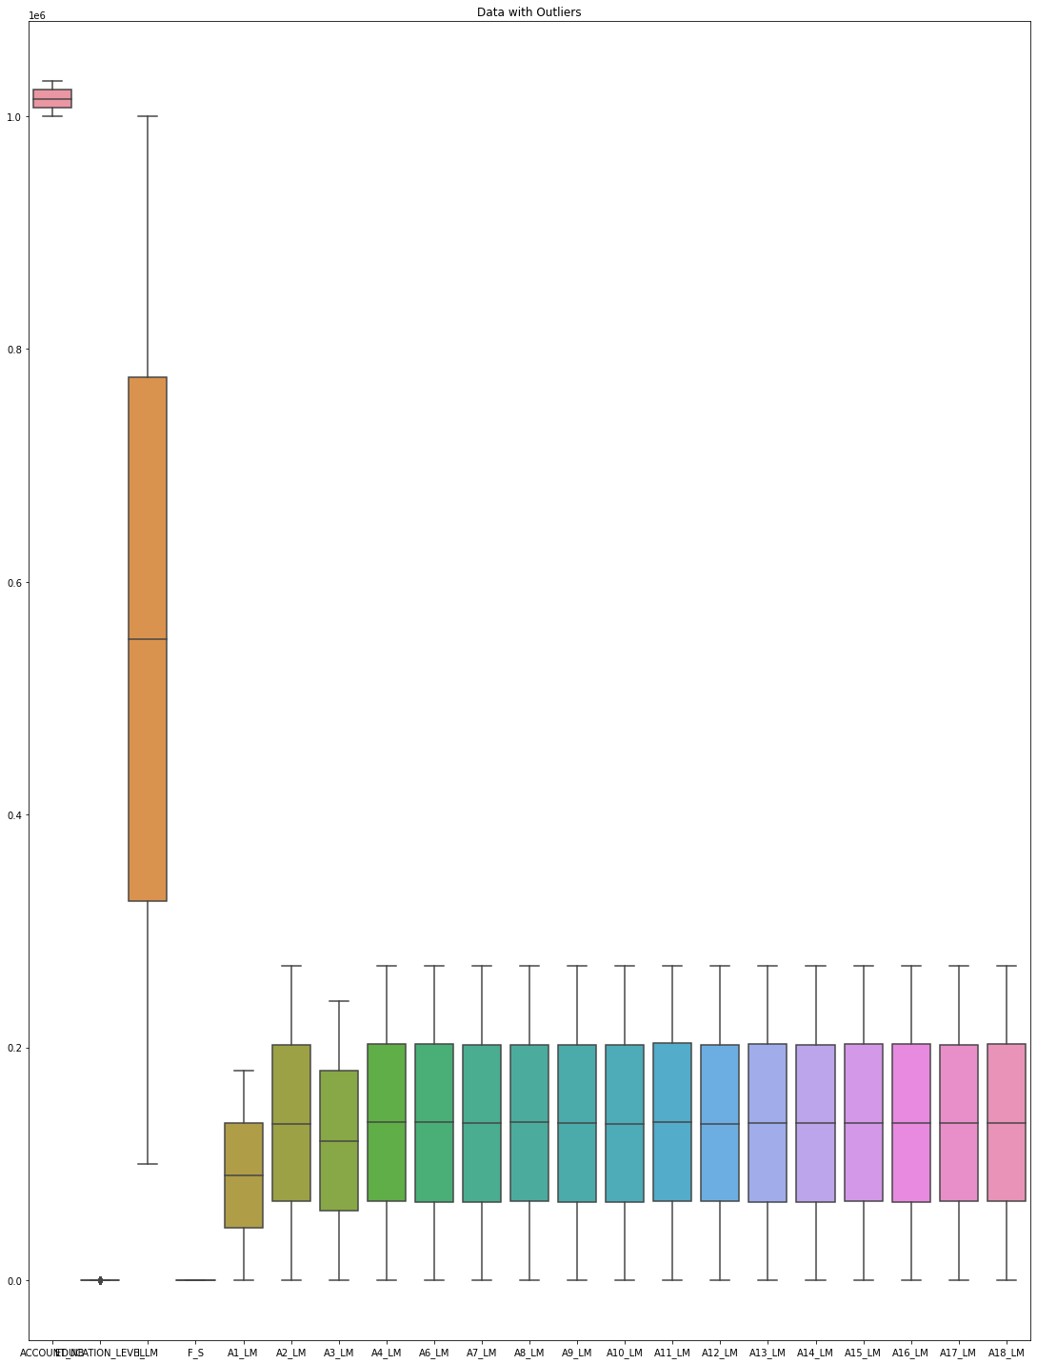
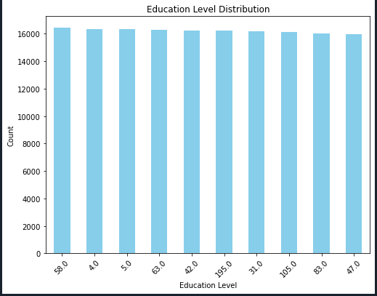

Slide 12
EXPLORATORY DATA ANALYSIS
Here, the dependent variable is Y/N, ie has the client subscribed to a term deposit
In our dataset related to direct marketing campaigns of a Portuguese banking institution, the primary objective is to understand the factors influencing client’s subscription to the bank term deposit.
To analyse the data effectively, the chosen appropriate statistical tests are based on the nature of our variables:
The dependent variable is categorical
ANOVA Test (Analysis of Variance):
Utilized for continuous independent variables.
Chi-Square Test:
Applied for categorical independent variables.

Slide 13
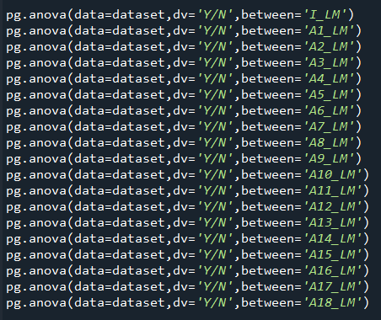
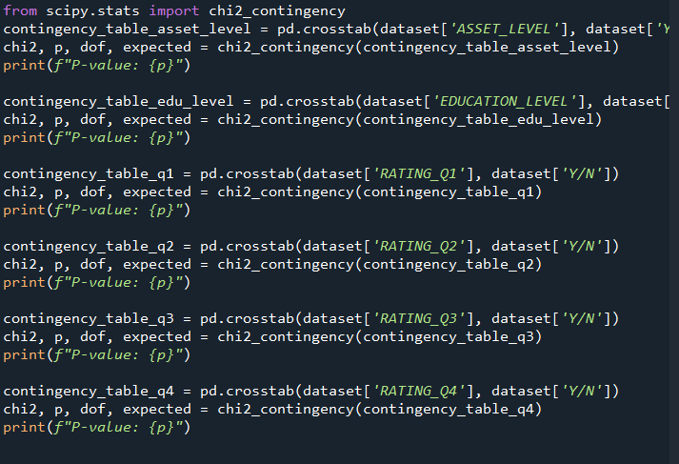
EXPLORATORY DATA ANALYSIS

Slide 14
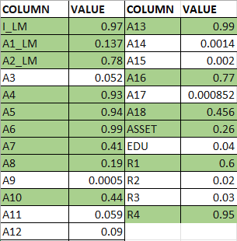
P VALUES(0.10)

Slide 15
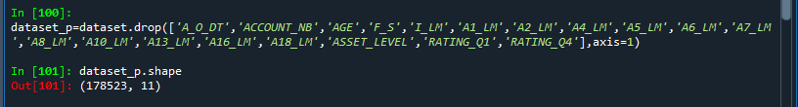

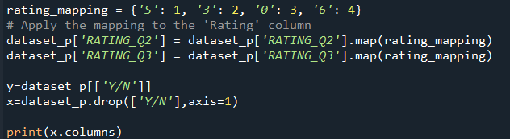
EXPLORATORY DATA ANALYSIS

Slide 16
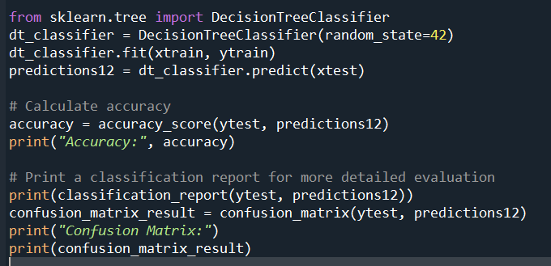
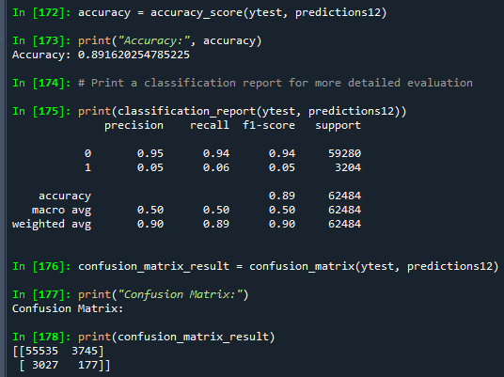
DECISION TREE MODEL
ACCURACY=89%

Slide 17
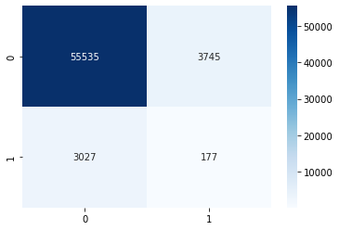
CONFUSION MATRIX

Slide 18
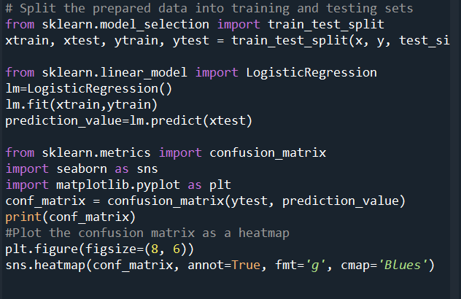
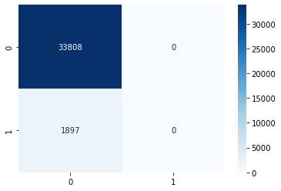
LOGISTIC REGRSSION MODEL
ACCURACY:94%

Slide 19
CONCLUSION
Based on the analysis, certain key features significantly influence the decision to subscribe to a term deposit.
Specifically, columns such as:
EDUCATION_LEVEL', 'A3_LM', 'A9_LM', 'A11_LM', 'A12_LM', 'A14_LM','A15_LM', 'A17_LM', 'RATING_Q2', 'RATING_Q3’
They demonstrated a strong impact on customer behavior.
Client’s account balance from the previous 7 months effected their decision for a term deposit. Moreover, their activity in quarters 2 and 3 influenced their decision as well.
Understanding these influential factors can assist in targeted marketing strategies and customer engagement efforts.

